Slide 1
Ship Better, Faster
@jamesrcounts |@paulwhitmer

Slide 2



Jim Counts
Legacy Code Expert
DevOps Enthusiast
Polyglot programmer
Full stack consultant

Slide 3

Paul Whitmer
Full stack asp.net MVC
C#/Angularjs/Nodejs/cloud
Linux/windows
Devops/Linux TIG Mentor

Slide 4
Ship Better, faster
Why care about CI/CD?
What is it?
How To
Compile/prepare code on a build server
Run unit/integration/BDD test suites
Deploy to multiple environments
Nuts & Bolts Example

Slide 5
Why care about CI/CD?
Primary goal of development activities is to deliver value to our customers
Features
Bug Fixes
Performance
Deployment activities are just necessary overhead to delivering value
Ci/CD Lets Us Automate This Overhead and make it less Expensive

Slide 6
Ship Better, faster
Why care about CI/CD?
What is it?
How To
Compile/prepare code on a build server
Run unit/integration/BDD test suites
Deploy to multiple environments
Nuts & Bolts Example

Slide 7
What is it?
Developer
Source Control
Build Server
Deployment

Slide 8
Ship Better, faster
Why care about CI/CD?
What is it?
How To
Compile/prepare code on a build server
Run unit/integration/BDD test suites
Deploy to multiple environments
Nuts & Bolts Example

Slide 9
How To
Compile/prepare code on a build server
Run unit/integration/BDD test suites
Deploy to multiple environments

Slide 10
Compile/prepare code on a build server
Getting Code to the server - Automatic
Build server monitors Repository
Checks out code when it changes
Runs the build (msBUild/Grunt/Gulp/etc.)
Developer – Checks in frequently
Get feedback more often
Find hidden assumptions in the build process
Optimize what is slow

Slide 11
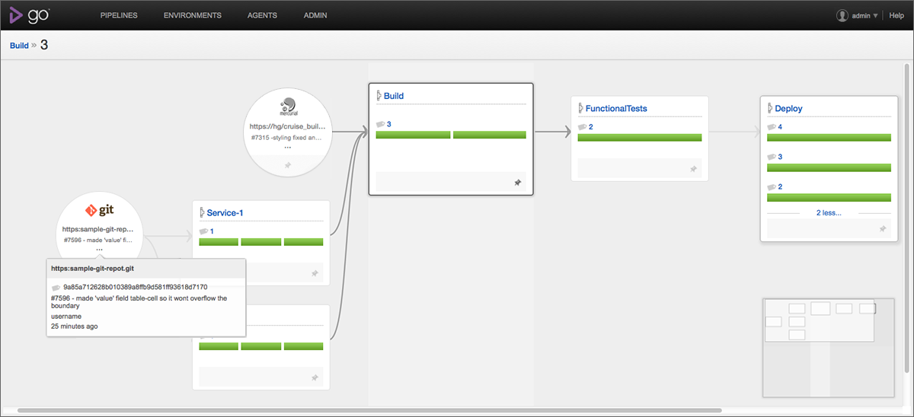
Compile/prepare code on a build server

Slide 12
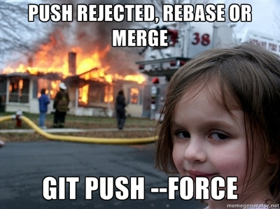
Compile/prepare code on a build server
Get Feedback MORE Often

Slide 13
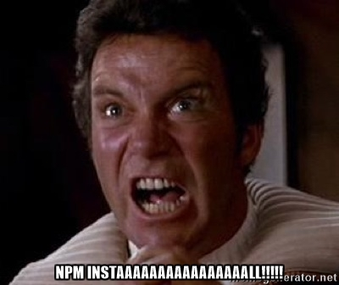
Compile/prepare code on a build server
Optimize What’s Slow

Slide 14
How To
Compile/prepare code on a build server
Run unit/integration/BDD test suites
Deploy to multiple environments

Slide 15
Run unit/integration/BDD test suites
Build server is just fancy way to run scripts
Usually very easy to run unit tests
Integration Tests may require a little thought (package dependencies)
Acceptance Tests Should Run Against a deployed environment

Slide 16
How To
Compile/prepare code on a build server
Run unit/integration/BDD test suites
Deploy to multiple environments

Slide 17
Deploy to multiple environments
identical environments for different purposes
Dev – QA – Production
Easy due to Automation
Only deploy “binaries” after acceptance

Slide 18
Ship Better, faster
Why care about CI/CD?
What is it?
How To
Compile/prepare code on a build server
Run unit/integration/BDD test suites
Deploy to multiple environments
Nuts & Bolts Example

Slide 19
Nuts & Bolts Example
Developer Changes
Server Detects Changes
Assign to Cloud Agent
Prepare and Test Deployment Zip
Generate Custom Boot Script
Deploy new server

Slide 20
Demo

Slide 21
When a new Server Launches…
How Does it find the code?
What Set of firewall rules should apply?
What security Groups Should it Be part of?
What network should it launch into?
Which access keys should be loaded onto it?

Slide 22
When a new Server Launches…
Baseline Instance
Pull zip from storage
Connect to Load Balancer

Slide 23
Baked in boot script
Get the app
Download from Storage
Unzip
Run
Add to load balancer
Wait to become healthy
Tell load balancer to remove other versions of the app
Setup tags
Wait for death

Slide 24

Baked in Death Script
AM I Attached to load balancer?
No – “Amazon, please kill me”
Yes! – “The world loves me, do nothing”
Wait one minute then check again

Slide 25
Lessons
Remove human error
Don’t wait for a human to kick off build/deployment
Don’t write custom scripts per environment, use templates
Don’t rely on humans to clean up, allow resources to retire themselves
Go back to basics if you need to
Shiny tools promise magic but often come with their own learning curve
There is usually a way to Customize automation for your specific needs
You can always bring back the high level tool once you understand your Requirements better

Slide 26

Questions?

